Slide 1
Imperativ
The Imperative Mood in BCS

Slide 2
What is imperative?
The imperative is a grammatical mood used to form commands or requests, including the giving of prohibition or permission, or any other kind of exhortation.
Etymology: Latin impero: to command (zapovedati/zapovijedati)
In English, the imperative is formed using the bare infinitive form of the verb.
Let us read! Please, listen! Please, give me some water! Please, be quiet!
The imperative is negated using don't, as in "Don't touch me!"

Slide 3
Imperative in English
The imperative form is understood as being in the second person (the subject pronoun you is usually omitted, although it can be included for emphasis), with no explicit indication of singular or plural.
First and third person imperatives are expressed periphrastically, using a construction with the imperative of the verb let: Let us have a drink! * Let him/her/them be happy! (constructions with may are also used)

Slide 4

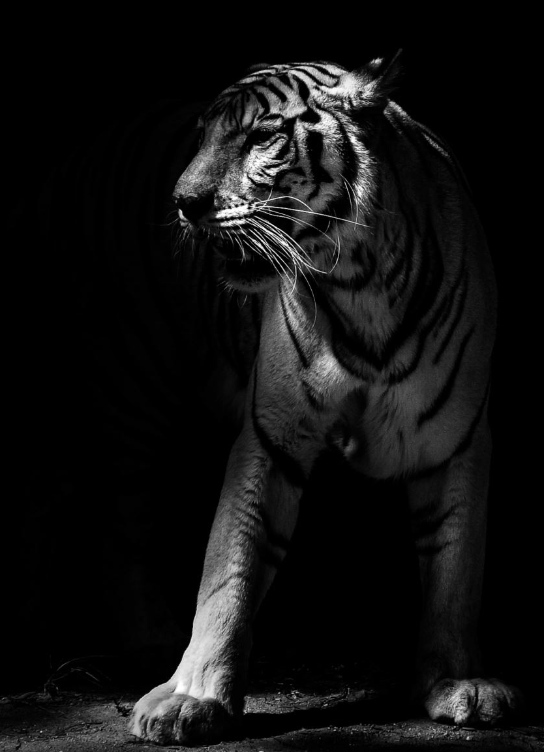
usage
Imperatives are used principally for ordering, requesting or advising the listener to do (or not to do) something: "Pass me the sauce"; "Don't go too near the tiger."
They are also often used for giving instructions as to how to perform a task ("Install the file, then restart your computer"). They can sometimes be seen on signs giving orders or warnings ("Stop"; "Give way"; "Do not enter").

Slide 5
Politness
The use of the imperative mood may be seen as impolite, inappropriate or even offensive in certain circumstances. In polite speech, orders or requests are often phrased instead as questions or statements, rather than as imperatives.
Could you come here for a moment? (more polite than "Come here!")
It would be great if you made us a drink. (for "Make us a drink!")
I have to ask you to stop. (for "Stop!")

Slide 6
Usage part 2
Imperatives are also used for speech acts whose function is essentially not to make an order or request, but to give an invitation, give permission, express a wish, make an apology, etc.:
Examples:
Come to the party tomorrow! (invitation)
Eat the apple if you want. (permission)
Have a nice trip! (wish) Pardon me. (apology)
When written, imperative sentences are often, but not always, terminated with an exclamation mark.

Slide 7
Imperative in BCS
Imperatives of this type imply a second person subject (you); some languages like BCS also have first person plural and third person singular imperatives, with the meaning of "let's (do something)" or "let him/her/them (do something)".
BCS Imperative has 3 forms:
1st person plural
2nd person singular
2nd person plural.
The first person plural is actually not a command in the strict sense, but rather an invitation to do something along with the speaker (English-let’s….)

Slide 8
Formation of Second person singular (TI)
STEP 1
Start with a 3rd person plural of the present tense! (oni, one, ona)

Slide 9
STEP 2
Drop the final vowel from the 3rd person plural (either E or U)
Step 2:
Pišu - piš
Čitaju- čitaj
Kupuju- kupuj
Daju-daj
Pevaju/pjevaju- pevaj/pjevaj
Misle -misl
Dođu –dođ

Slide 10
Step 3
Add -I to obtain the second person singular imperative:
Pišu- piš= piši
Vide- vid= vidi
Nose- nos= nosi (nositi- carry, wear)
Izlaze –izlaz- izlazi (izlaziti- go out)
Dođu- dođ- dođi

Slide 11
If there is J left after dropping E/U
If after step 2 there is J at the end of the stem and the vowel before the J is short (which is the case for the majority of SCR verbs) DO NOT ADD -I.
Also the vowel before the J that is short in the present tense becomes LONG in the imperative:
The stress is marked in bold and the length is underlined and in bold:
Čitaju :Čitaj; Kupuju: Kupuj

Slide 12
Verbs with long vowels
There are a few verbs which have the long vowel before J in the present tense- these form the imperative like those desribed in the step 3.
Also, remember the exception of the verb razumeti/razumjeti to understand is razumi
Razumi me, molim te! Please, understand me! Also: shvati me (used more!)

Slide 13
Verbs -ĆI
Verbs with infinitives in -ći (such as peći, teći, pomoći, etc.) and either K, G, KN, or GN before U -in the third person plural of the present tense form the second peson singular imperative by adding -i to K or G which imediately alternate producing C and Z (K:C alternation)
Peku- pek- pek+ i= peci (peći-to bake)
Teku- tek- tek+ i= teci (teći-to flow)
Pomognu- pomogn- pomog+i= pomozi (pomoći- to help)

Slide 14
Exceptions RECI AND KAŽI
There will be exceptions to this main rule such as 3rd person plural kažu (of kazati) and its imperatives reci or kaži which must be memorized!
Explanation: the infinitive reći (to tell) would have ungrammatical 3rd person plural reknu (the proper form is kažu!!!) which follows the KN group (see the above rule on alternation) rekn+ i= reci.
Remember that in present tense the form is kazati: kažem, kažeš, kaže, kažemo, kažete, kažu, but in imperative the second person singular is reci from the infinitive reći. Infinitive kazati has also the imperative kaži!
(There will be exceptions to the main rule and we will study these verbs as we encounter them, but for the time being remember reci exception!)

Slide 15
Forming the First and the Second Person Plural
The first and the second Person Plural are formed by adding –mo and –te respectively to the 2nd person singular imperative
2nd person singular imperative: čitaj, kupuj, vidi, piši, pođi, reci, pomozi
1st person plural: čitajmo, kupujmo, vidimo, pišimo, pođimo, recimo, pomozimo
2nd person plural: čitajte, kupujte, vidite, pišite, pođite, recite, pomozite
The English equivalent would be Let’s (do something)

Slide 16
Indirect Commands
indirect command for the 3rd person, who is not directly participating in the conversation and whom consequently you cannot order directly
Formation: neka + the 3rd person singular or plural present tense (depending on the number of people)
Neka on piše. Let him write.
Neka ona čita. Let her read.
Neka oni rade. Let them work.
Neka one pevaju/pjevaju. Let them sing (females)
Neka niko/nitko ne govori. Don’t anybody talk.

Slide 17
Negative Commands
OPTION 1: can be formed with a straightforward negation of the verb in the imperative form:
Ne govori! Don’t speak!
Ne govorite! Don’t speak! (formal adress or plural)
OPTION 2: Another common negative command is made with the forms Nemoj, Nemojmo, Nemojte and da+present tense or infinitive of the main verb. The result is a mild, polite command or gentle warning, sometimes with the intonation of a request:

Slide 18
PRIMERI
Nemoj da se ljutiš, mama or Nemoj se ljutiti, mama
Don’t get angry, mommy/(ljutiti se/naljutiti se- to get angry)
Nemoj da vičeš or Nemoj vikati
Don’t yell…
Nemojte da govorite o tome, molim vas! or Nemojte govoriti o tome, molim vas!
Please, don’t talk about that!
Note: for the first person plural either Nemojmo or Nemoj can be used:
Nemoj(mo) da govorimo o tome! Nemoj(mo) govoriti o tome!
Let’s not talk about that!
Here in plural nemoj is short of nemojmo and don’t confuse it with singular form nemoj!

Slide 19

Imperative of biti
Imperative of biti:
2nd person singular: budi
Budi dobar! Be nice! (also: Behave!)
1st peson plural: budimo
Budimo veseli. Let’s be joyful!
Budimo ljudi! Let us act as human beings!(lit. let us be humans!)
2nd person plural: budite
Budite tihi! Please, be quiet!

Slide 20

Indirect Command (neka+present)
Neka on bude kod kuće.
Let him be (stay) at home.
Neka ona bude dobra ili ću se jako naljutiti. She better be nice, or I’ll get very angry!
Neka ono bude dobro (dete/dijete).
Let him/her be a good child.
Neka oni, one, ona budu srećni/sretni.
Let them be happy.

Slide 21
The negative command may use either negation of the direct command forms, i.e., ne budi or the following special forms
Nemoj da budeš lenj/ lijen
or Nemoj biti lenj/ lijen Don’t be lazy!
Nemojmo da budemo bezobrazni!
or Nemojmo biti bezobrazni! Let us not be rude (impertinent)!
Nemojte da budete takvi!
or Nemojte biti takvi! Don’t be like that!

Slide 22
PLEASE, MOLIM TE
English “please” is rendered as: molim te -when adresing a person informally or
molim vas -when adresing a person formally or a group of people (plural)
Both molim te and molim vas are followed by comma (or preceded by comma if the phrase is at the end of the sentence):
Izvinite, molim vas, znate li koliko je sati? Excuse me, please, do you know what time is it?
Ne ljutite se, molim vas! Don’t get angry, please!

